Slide 1
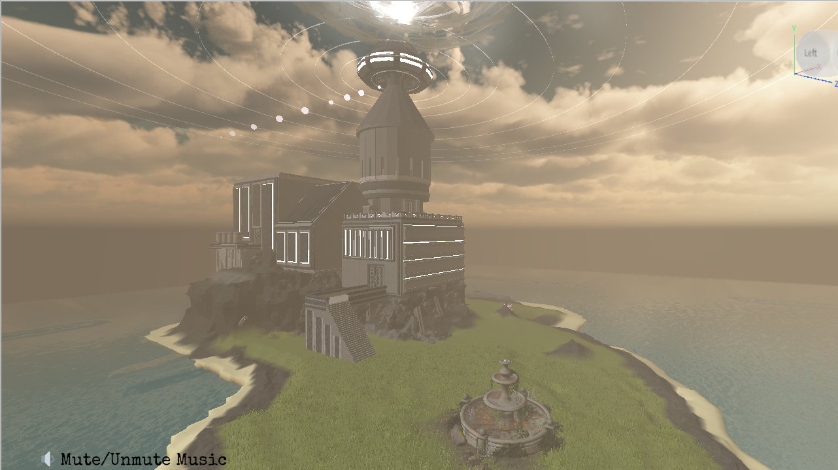
ROBLOX PROJECTS

